Slide 1
Burger Town – Smart QR code Ordering System
Team 7, Section 007
Sujai Shanmugam – Full-Stack Developer
Davyd Bogomolov – Front-End Developer
Arseni Prykhodko – Back-End Developer
Gasim Jabrayilov – Back-End Developer
Abbas Rzayev – Front-End Developer
Rufi Aliyev – Full-Stack Developer
GitHub Link - https://github.com/davidbo9omolov/team7-section007-finalproject

Slide 2
Project Overview and Motivation
Problem Solved:
Reduces wait time and increases efficiency in restaurants by enabling contactless ordering.
Target Users:
Restaurant customers, restaurant employees (wait staff), and restaurant managers.
Relevance:
Post-pandemic trends favor contactless service which enhances dining experience and operational control.

Slide 3
SDLC Methodology
Model: Agile SDLC Agile SDLC is a software development model where work is done in small, repeatable steps (called sprints), allowing teams to build, test, and improve quickly. It mainly focuses on continuous feedback and flexibility to adapt to changing requirements.
Why Agile?
Agile was chosen for our project because it allows us to get frequent feedback, make quick changes based on the owner’s needs, and add features step by step, which helps improve the system continuously and meet the owner’s expectations.

Slide 4
Requirements Gathering & Analysis
Team 7 collected requirements by discussing with the restaurant owner (Praveen Krishnan), wait staff, and potential customers in person and observed how orders were placed and managed in a real restaurant setting.
Questions asked
What problems do you face with the current ordering system?
Would you prefer the customers to order using their phones?
What kind of tools would make it easier for you to update the menu and keep track of customer orders in real time?
How can we make the ordering process easier for both staff and customers using a digital system?
Assumptions Made
Customers have access to smartphones with internet connectivity.
The restaurant environment supports QR codes at each table and provides Wi-Fi.
Staff are open to using digital tools to manage orders.
Managers want real-time visibility into customer orders and system updates.

Slide 5
Software Requirements Specification
Functional Requirements
Customers can scan a QR code to view the digital menu.
They can select, modify, and place orders through their device.
Staff can update order statuses ("In Progress", "Ready", "Served").
Customers can track order status in real-time.
Admins can manage the menu and monitor all orders via a dashboard.
Non-Functional Requirements
Usability: The system should be easy to use for all types of users.
Performance: The platform should load quickly and handle multiple orders at once without lag.
Reliability: The system must work consistently without crashes or bugs.
Security: Customer data and order information must be protected.
Responsiveness: The UI should work smoothly across all devices (phones, tablets).

Slide 6
28
Development guided by requirements
These Functional and Non-functional requirements helped us (Team 7):
Design user-friendly interfaces for customers, restaurant staff, and admins.
Use responsive design so the site works on all screen sizes, phones, tablets, etc.
Focus on fast and secure features, like order tracking and real-time updates.
Implement modular components, making it easier to upgrade or add features later.

Slide 7
System and Software Design
Key Design Decisions
Modular Architecture
The system was divided into three main modules such as Customer Interface, Staff Dashboard, and Admin Panel to make sure the separation of concerns and easier maintenance.
QR Code Integration
Decided to use dynamic QR codes that redirect users to a restaurant website
Real-Time Updates
Used a status tracking system for real-time updates of order status for both staff and customers.
Responsive Design
Chose a mobile-first approach since most users would access the system via smartphones.

Slide 8
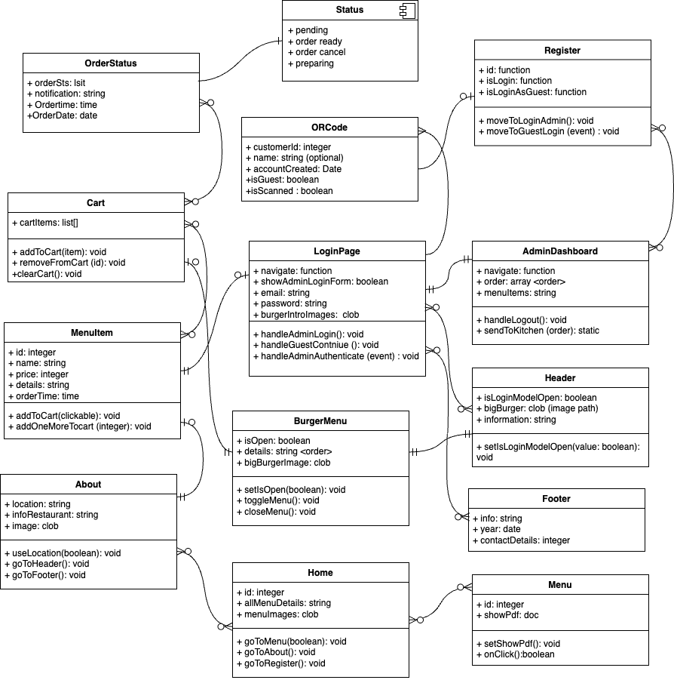
Design Alternatives Considered
Initially considered using one static URL for all tables with customers manually entering their table number, but we switched to dynamic QR codes per table to reduce errors and simplify the customer experience.
Considered using a native mobile app but opted for a web-based system to make it accessible without requiring downloads.
Explored integrating external order management systems, but developing a custom order tracker gave the team 7 more control and flexibility.
UML/class diagrams

Slide 9
Implementation Phase
Technologies used
Code Organization
Front-End: React.js and Tailwind CSS for building responsive and interactive user interfaces.
Back-End: Node.js and Express.js for handling APIs, order processing, and data communication.
Database: MongoDB to store order details, menu items, and user data.
QR Code Generator: ORFY for Dynamic QR code to redirect to a restaurant website.
Version Control: Git & GitHub for code collaboration and version management.
The code was organized into modular folders:
client/ -- front-end code (React components, pages, styles)
server/ -- back-end code (API routes, database models, business logic)
shared/ -- shared utilities like validation functions and constants
Followed naming conventions and used comments for clarity and maintainability.

Slide 10
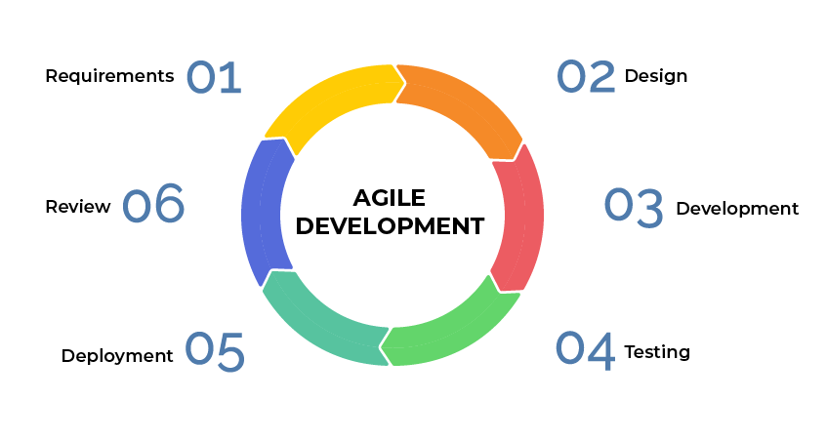

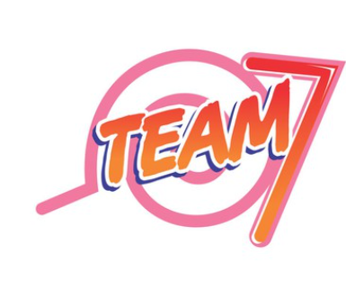





Teamwork approach
Used Agile methodology with daily stand-ups to track progress.
Tasks were divided based on roles:
Front-End: Davyd and Abbas
Back-End: Arseni and Gasim
Full-Stack Integration & Testing: Sujai and Rufi
Used Jira to manage tasks, deadlines, and progress.
Collaborated via GitHub branches and pull requests to avoid code conflicts.
Always connect through whatsapp for discussions and weekly meetings in RTU library in person.

Slide 11
Testing Strategy
Black-Box Testing Approach
Team7 used black-box testing, focusing on the user’s interaction with the system without checking internal code. Each test case was created based on expected user actions and the system’s expected responses.
We tested all major functionalities like scanning QR codes, placing orders, customizing items, tracking status, and admin updates.
Edge cases such as invalid selections, order cancellations, and peak-time performance were also tested.
Scenarios and Inputs Tested
Key scenarios included:
Scanning valid/invalid QR codes
Adding single or multiple items to the cart
Handling out-of-stock items
Customizing food items
Real-time order tracking
Admin menu updates during peak hours
Handling many customers ordering simultaneously
Each scenario was tested with valid and invalid inputs to ensure robustness and user-friendly feedback.

Slide 12
Test Results and Validation
Team7 created 11 test cases covering core and edge features.
Results were:
9 Passed – All expected outcomes were achieved, like smooth ordering, admin updates, and error messages.
2 Partially Passed – Minor issues like slight delay in order status updates and performance drop above 10 concurrent users.
Validation of Project goals
Team7 validated the project goals by considering that:
Customers could easily order using QR codes with no confusion.
Restaurant Staff could track and manage orders in real time.
Admins could update menus quickly without disrupting the user experience.
The system remained responsive under realistic loads users.
The test results confirmed that our project met functional and non-functional requirements, ensuring a smooth, modern dining experience.

Slide 13
Process Reflection and Lessons Learned
Challenges During Development
Team 7 learnt about
Software Engineering
Syncing updates between admin changes and customer views in real time was kind of hard for us at first.
Handling multiple users ordering at the same time caused some delays that the team 7 had to optimize.
Designing a smooth and simple user interface that worked well on both phones and tablets took more time than expected.
Sometimes we could not meet because of holidays and workloads in university works like, midterms, practical.
Regular testing and feedback help to fix and solve small types of issues early before they become big problems.
Clear communication and dividing tasks properly in the team made the project easier to manage and to finish.
“Building something user-friendly is not just about coding it’s also about thinking like the end user.”

Slide 14
Demo Overview
Demo Related to SDLC Steps
Features Demonstrated
Requirements & Analysis: As the owner told the team 7, all demo features were based on what customers, staff, and admins needed.
Design: The flow of ordering and managing items was planned to be simple and user-friendly
Implementation: Team 7 used the planned tech stack and divided tasks to develop each part as team 7 discussed.
Testing: The demo includes features that passed black-box testing and reflect real use cases.
Deployment: The working system shown in the demo reflects a ready-to-use product.
Scanning a QR code to view the menu linked to the restaurant website.
Selecting and customizing food items
Adding items to cart and placing an order
Tracking order status in real time through customers dashboard.
Admin login, updating the menu, and viewing orders

Slide 15
Conclusion and Future Work
Results summary
Future Improvements
The system successfully provides a contactless, smooth ordering experience
Real-time updates and admin control worked reliably under normal loads
The user interface is easy to navigate and works on all modern devices as the owner of the restaurant expected.
Add support for payment integration like Stripe, PayPal
Implement real-time notifications using some features like Web Sockets for faster updates for the admin and for customers as well
Add multi-language support for international users
Improve performance under high load for peak hours
Include a customer feedback/rating system after order completion for the restaurant Burger Town.

Slide 16
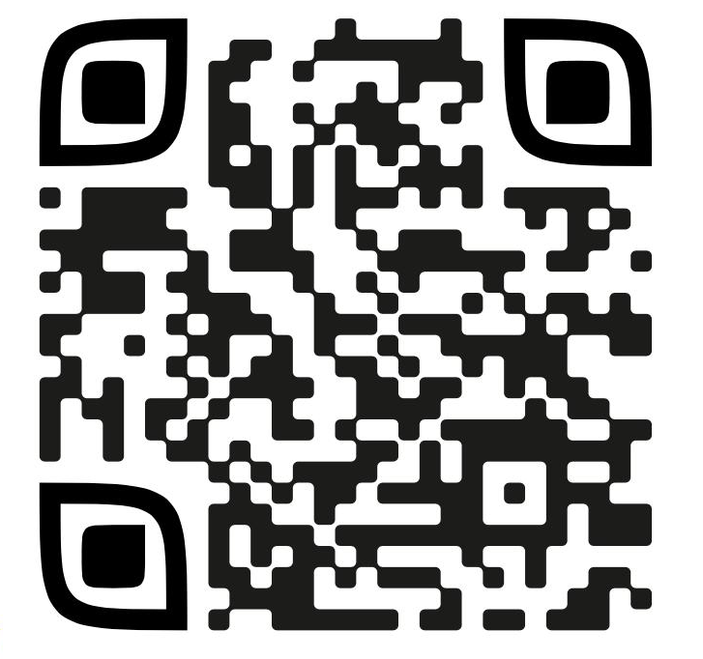
THANK YOU!
Scan & Check it!

